Slide 1
Data Visualization of Bird Strikes between 2000 – 2011

Slide 2
Introduction
Problem Statement
Transport and communication analytics play a vital role in addressing contemporary challenges, notably environmental impacts and safety concerns. Among these challenges, bird strikes in aviation stand out as a significant threat. Bird strikes, defined as collisions between birds and aircraft, can cause substantial damage and pose risks to aircraft safety, especially during take-off, climb, approach, and landing. This presentation delves into the issue of bird strikes in aviation, highlighting their prevalence and impact, and explores potential solutions leveraging technology and analytics for enhanced safety.

Slide 3
Data Sharing Agreement:
Sample File Name: Bird Strikes_Final.xlsx
Number of Columns: 25559
Number of Rows: 26
Column Names:1)Record ID 2)Aircraft: Type 3)Airport: Name 4)Altitude bin 5)Aircraft: Make/Model 6)Wildlife: Number struck 7)Wildlife: Number Struck Actual 8)Effect: Impact to flight 9)FlightDate 10)Effect: Indicated Damage 11)Aircraft: Number of engines? 12)Aircraft: Airline/Operator 13)Origin State 14)When: Phase of flight 15)Conditions: Precipitation 16)Remains of wildlife collected? 17)Remains of wildlife sent to Smithsonian 18)Remarks19)Wildlife: Size 20)Conditions: Sky 21)Wildlife: Species 22)Pilot warned of birds or wildlife? 23)Cost: Total $ 24)Feet above ground 25)Number of people injured 26)Is Aircraft Large?

Slide 4
Architecture :
START
GET DATA
DATA VALIDATION
DATA TRANSFORMATION
END
DATA VISUALIZATION
DATA INSERTION INTO POWER BI

Slide 5
What techniques were you using for data pre-processing?
Removing unwanted attributes
Visualizing the relation of independent variables with each other and output variables
Checking and changing the Distribution of continuous values
Removing outliers
Cleaning data and imputing if null values are present.
Converting categorical data into numeric values.
Scaling the data

Slide 6
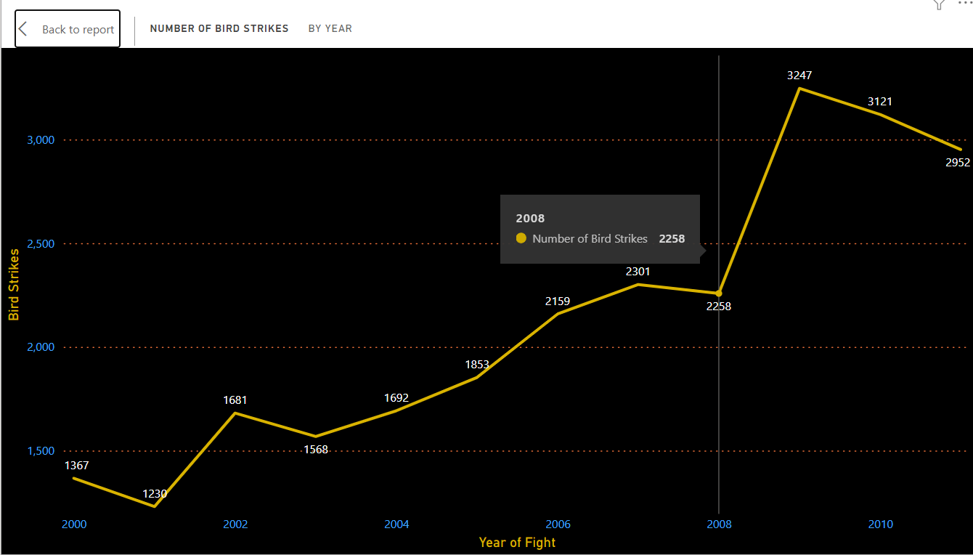
Yearly trends in bird strikes in the US.

Slide 7
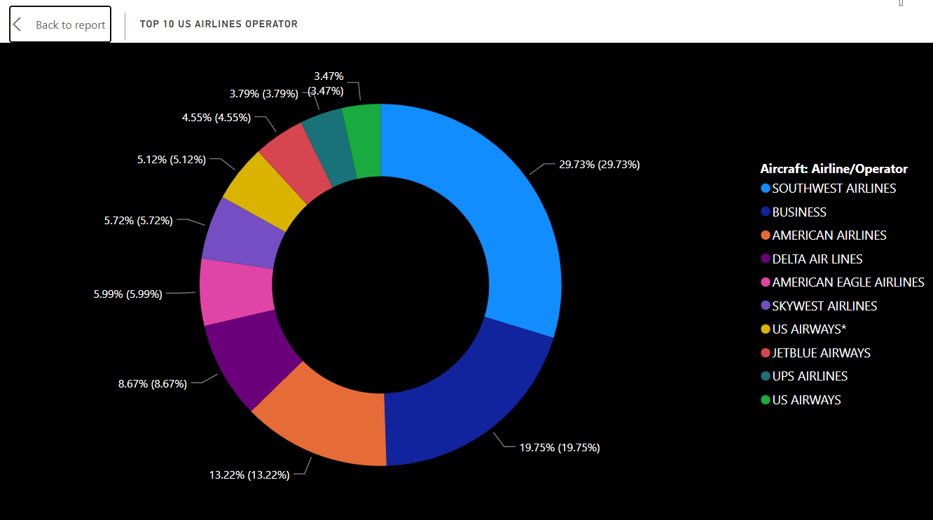
Top 10 US airlines with bird strike incidents.

Slide 8
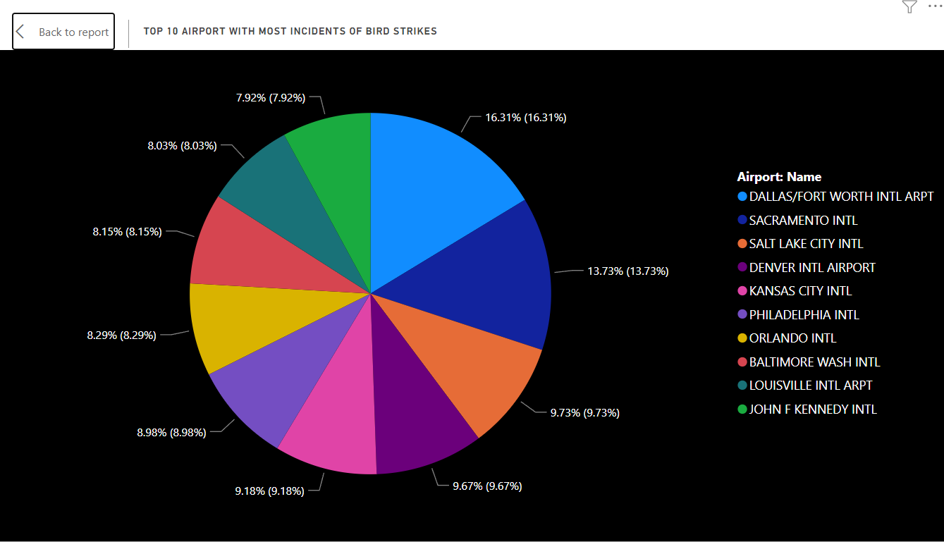
Airports with the most incidents of bird strikes.

Slide 9
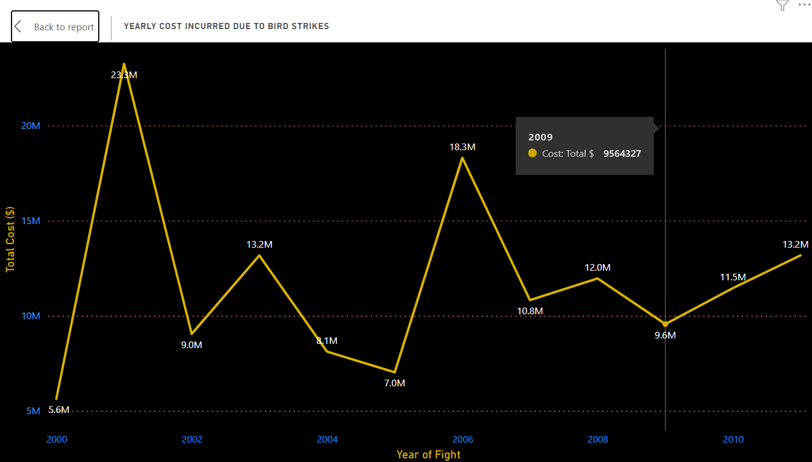
Yearly cost incurred due to bird strikes.

Slide 10
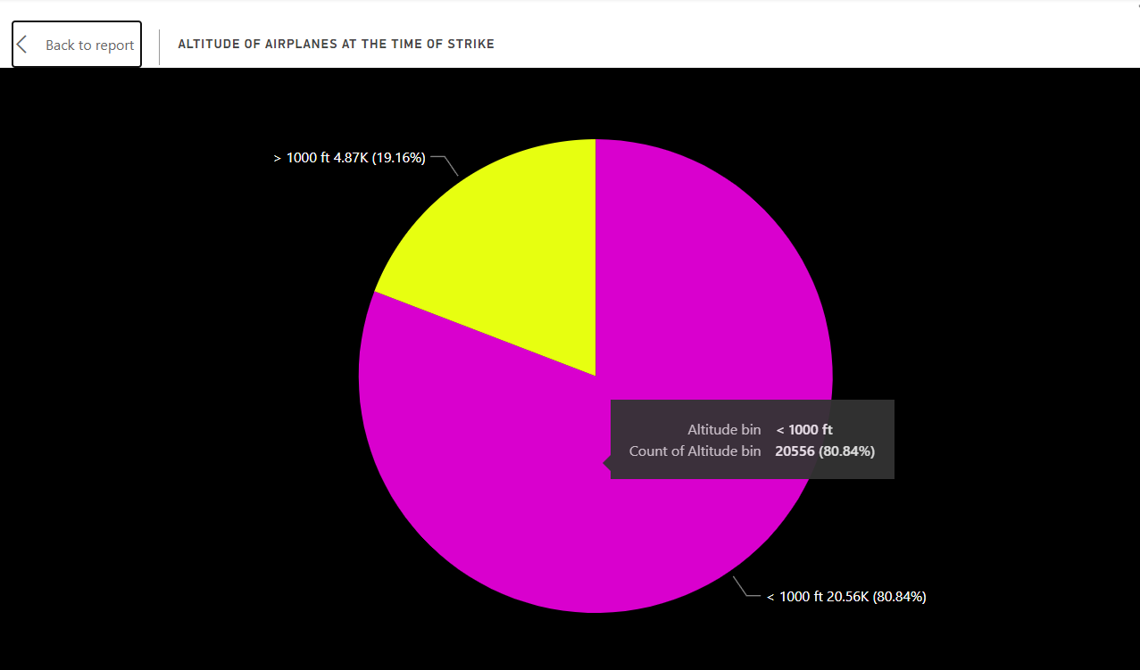
The altitude of the airplanes at the time of the strike

Slide 11
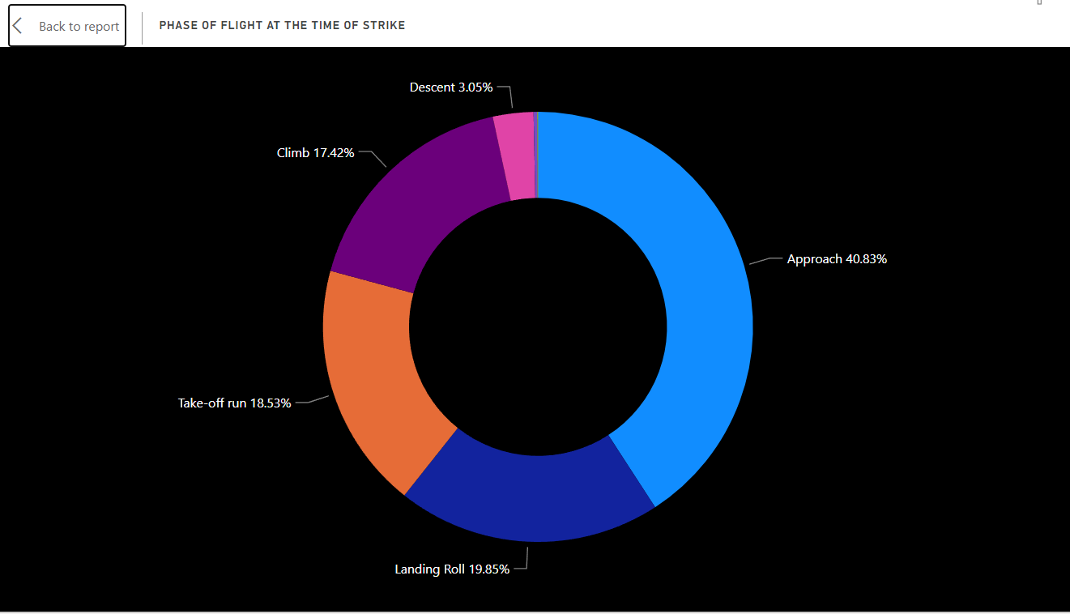
The phase of the flight at the time of strike

Slide 12
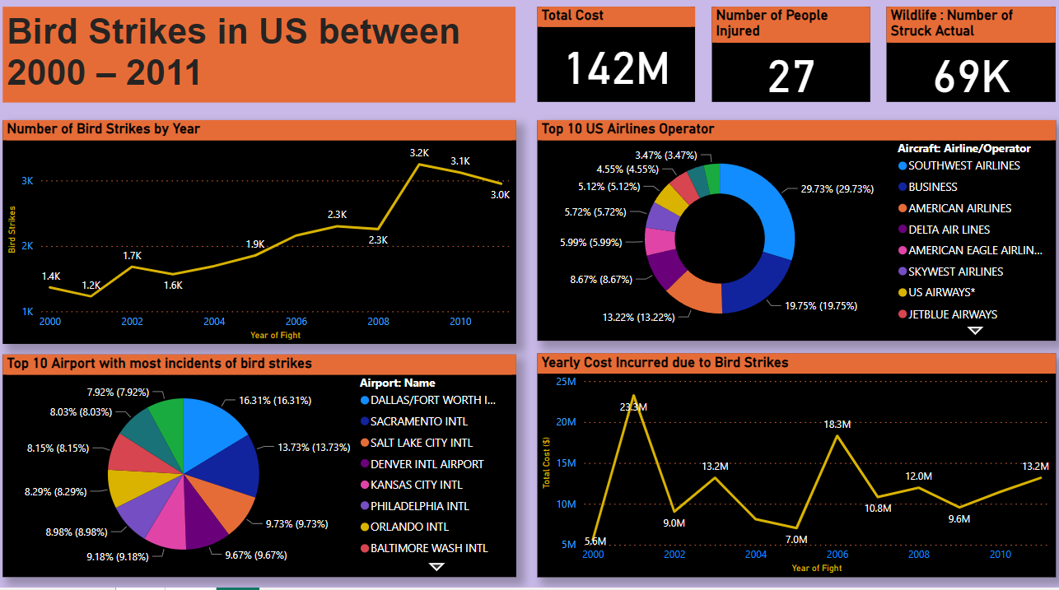
Result 1/2 :

Slide 13
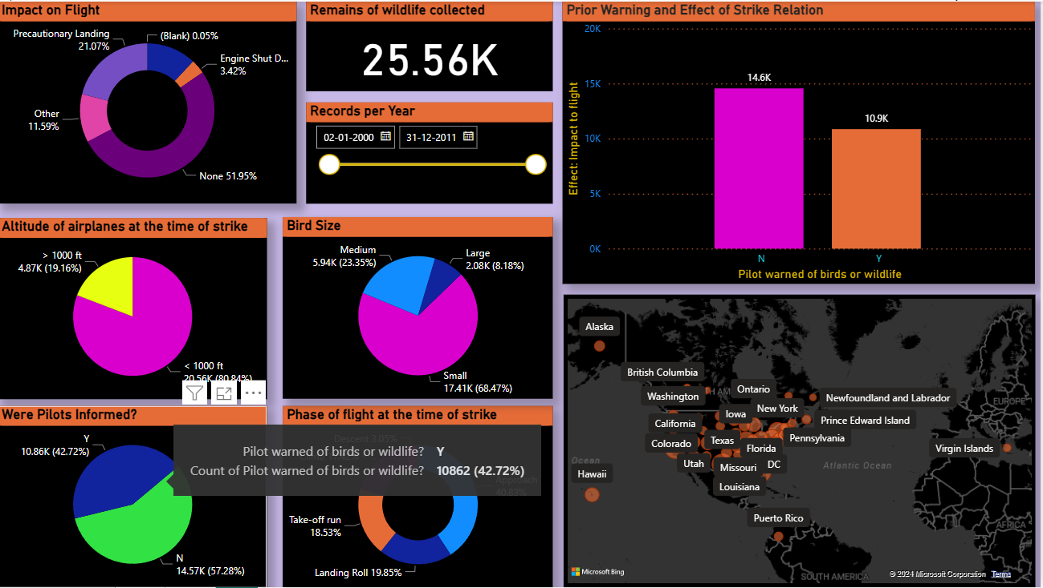
Result 2/2 :

Slide 14
Recommendations for Mitigating Bird Strike Risks:
Habitat Management: Control bird habitats near airports.
Bird Detection Systems: Implement radar and infrared sensors.
Aircraft Modifications: Enhance aircraft design for reduced susceptibility.
Wildlife Control Measures: Deploy non-lethal methods to deter birds.
Training and Awareness: Provide comprehensive training for aviation personnel.
Collaborative Research: Foster collaboration to understand bird behavior.
Regulatory Measures: Advocate for stringent regulations.

Slide 15
Suggestions for Further Research or Improvements:
Long-Term Efficacy: Evaluate the effectiveness of mitigation measures over time.
Technology Integration: Explore AI and drone applications.
Cost-Benefit Analysis: Assess the economic feasibility of measures.
Global Collaboration: Foster international cooperation.
Public Outreach: Raise awareness and encourage reporting.
Eco-Friendly Solutions: Develop environmentally friendly approaches.
Continuous Improvement: Foster innovation and proactive measures.

Slide 16
Conclusion
In conclusion, our analysis of bird strikes between 2000-2011 has provided valuable insights into the frequency, trends, and impact of these incidents on aviation safety. By visualizing the data, we identified temporal and geographical patterns, vulnerabilities in aircraft and airlines, and the financial implications of bird strikes. Our findings underscore the importance of proactive measures to mitigate the risk of bird strikes and enhance aviation safety.

Slide 17
Thank You

